Slide 1
Using Pester with Test Kitchen to thoroughly test your Chocolatey Packages
Cory Knox
@coryknox.dev

Slide 2
Pestering
about in the
(Test) Kitchen
Cory Knox
@coryknox.dev

Slide 3
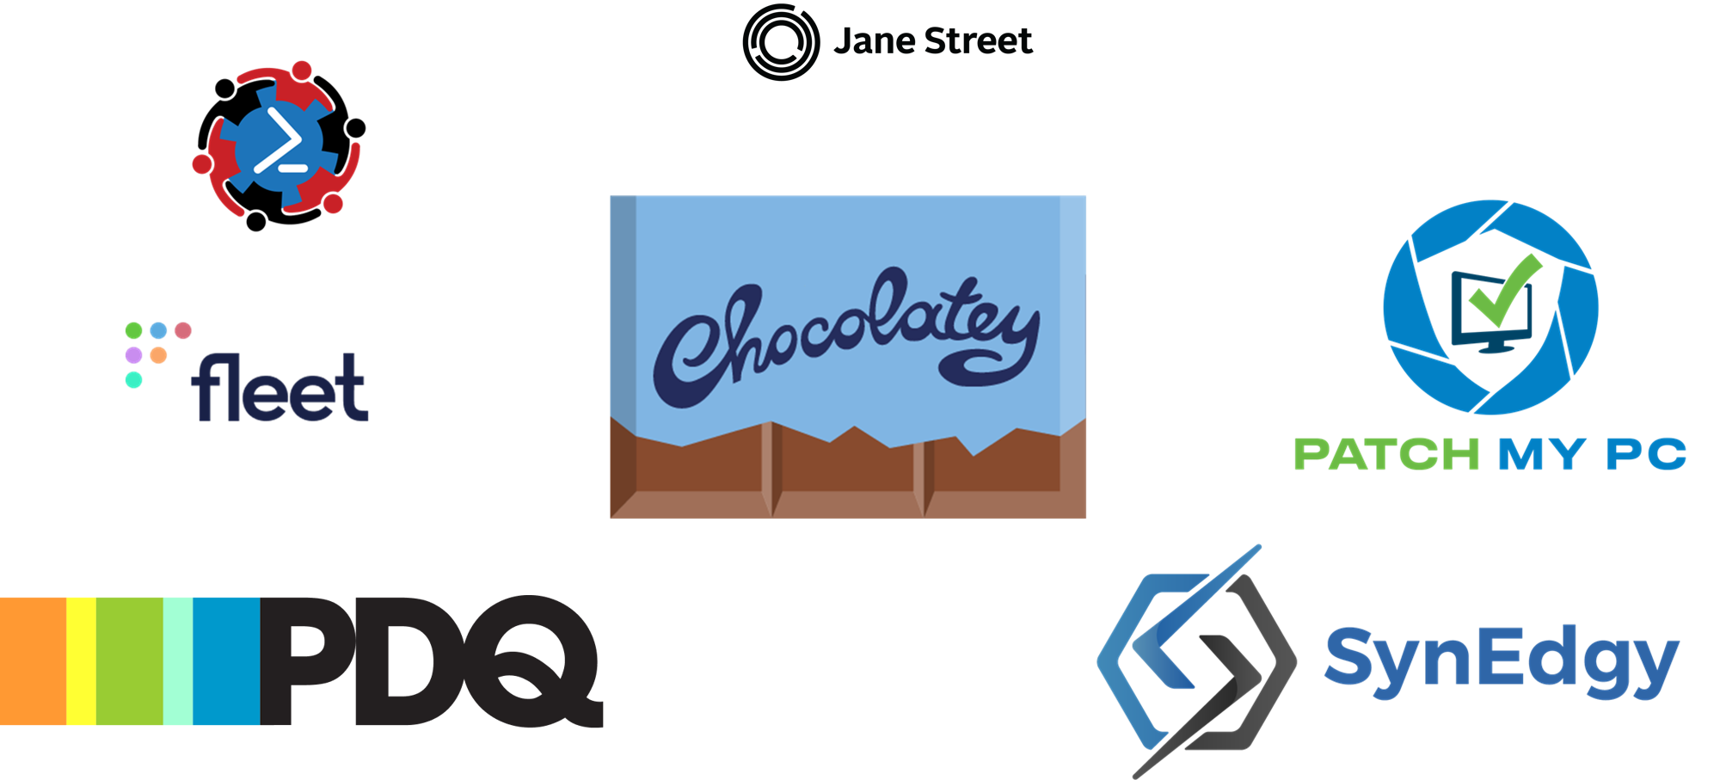

Slide 4



About me
I do computery type things
They work
Sometimes

Slide 5
About me
I do computery type things
They work
Sometimes
Software Engineer @ Chocolatey Software
10 years in End User Computer support
I’m on the internets: coryknox.dev/links

Slide 6
Small disclaimer
I work mostly with Windows systems.
Chocolatey works mostly with Windows systems.
Test Kitchen does not have that restriction.
While I’ll be showing Windows focused commands and configurations, they should work under any operating system.

Slide 7

What is Pester?
The test framework for PowerShell
Pester is the ubiquitous test and mock framework for PowerShell
https://pester.dev

Slide 8

What is Test Kitchen?
Test Execution platform
Allows simultaneous execution of tests on one or more platforms
https://kitchen.ci

Slide 9
How can it help
Identify issues with specific environments
Enable test reporting
Enable concurrent testing across environments

Slide 10
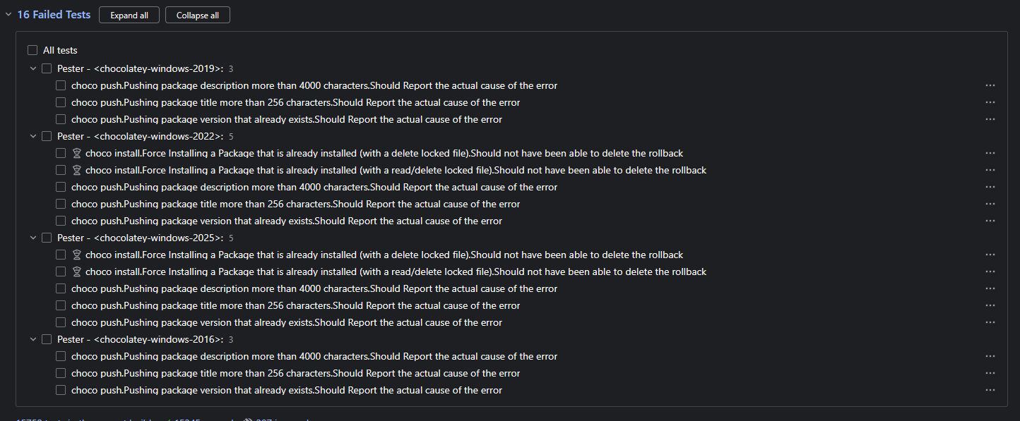
Identify issues in specific environments

Slide 11
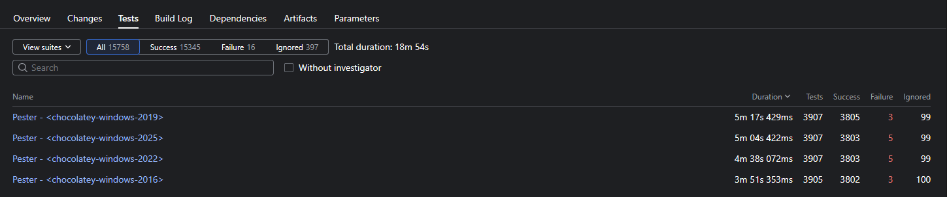
Reporting

Slide 12
What’s needed
Test Kitchen (part of Chef Workstation)
choco install chef-workstation
kitchen-pester (Rubygem that runs Pester within Test Kitchen)
chef gem install kitchen-pester
Your driver (Test Kitchen component that runs the environments)
For this demo, we’ll use Vagrant with Hyper-V backing…

Slide 13
Building the kitchen
Initialize the repository
git init
Initialize the Test Kitchen enironment
kitchen init
??? - Do some edits of the configuration
Honestly, this is usually easier to just take existing ones as a starting place
Profit!!!

Slide 14
Anatomy of a Test Kitchen command
kitchen <command> [<instance-name-regex>]
<command> - The Test Kitchen command to run
[<instance-name-regex>] - The Test Kitchen

Slide 15
Test Kitchen lifecycle
list – List state of each suite
create – Create VMs for each suite
converge – Install software on VMs
setup – Honestly, I’m not sure
verify – Run your tests
destroy – Shutdown and delete VMs
test – destroy then run through all levels

Slide 16
Demo time?

Slide 17
Questions?

Slide 18
THANK YOU
Feedback is a gift
Please review this session
via the mobile App

